Slide 1


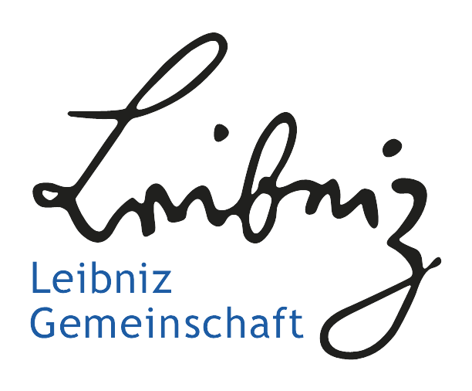
Origins of Parasitism
Internship at IZW and HU Berlin
Lydia Buntrock

Slide 2
Structure
Definitions
Motivation
Data
Methods
Timeline & first Results
References

Slide 3
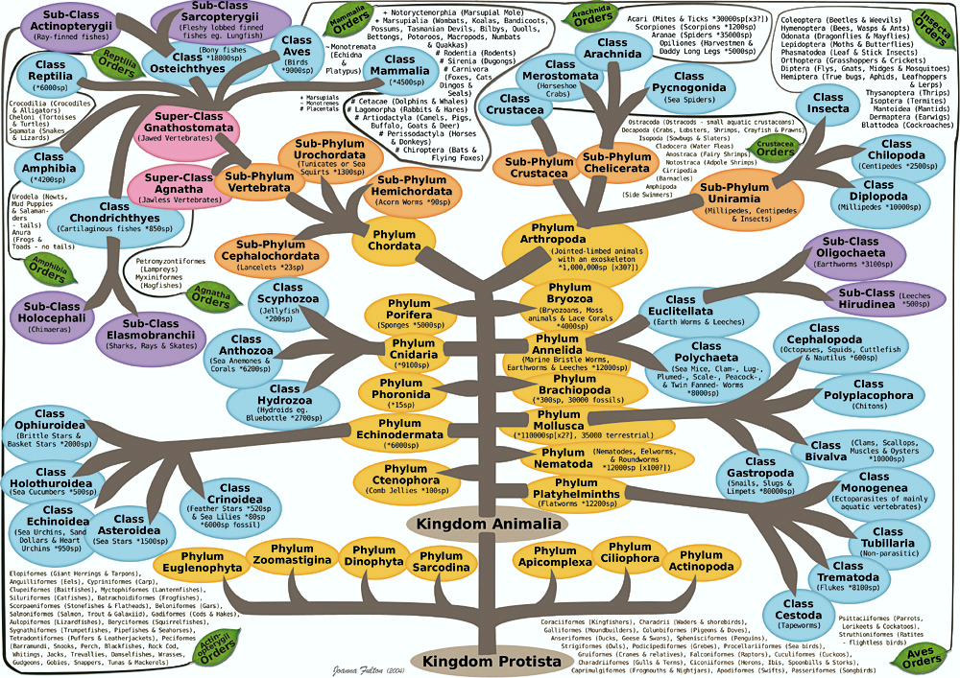
Definitions – Taxonomic tree

Slide 4
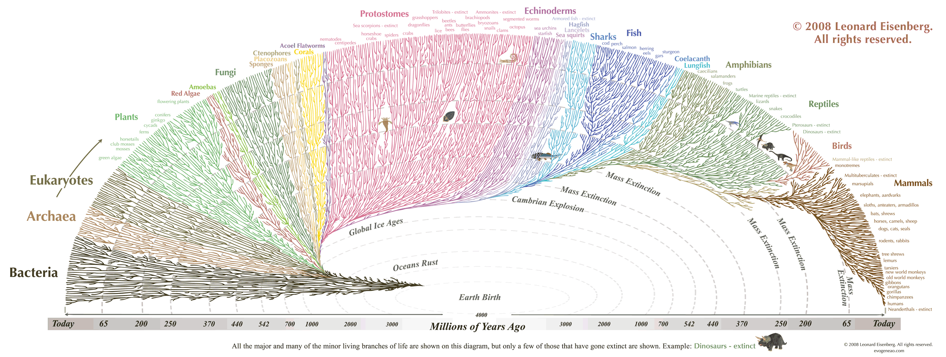
Definitions – Phylogenetic tree
Phylogenetics:
study of evolutionary history
relationships among individuals or groups of organisms
Result: phylogeny / phylogenetic tree
→ data structure as hypothesis about the history of the evolutionary relationships of a group of organisms

Slide 5
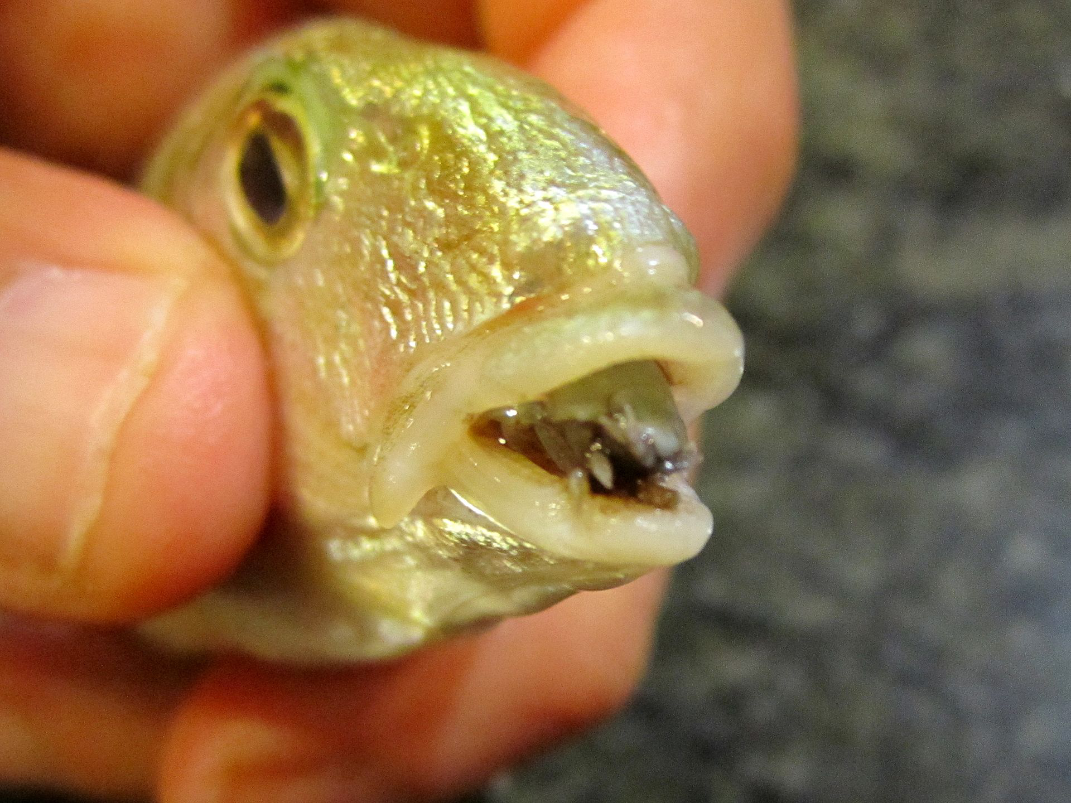
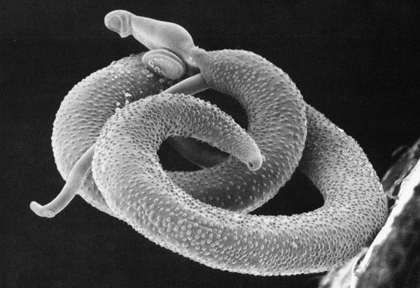
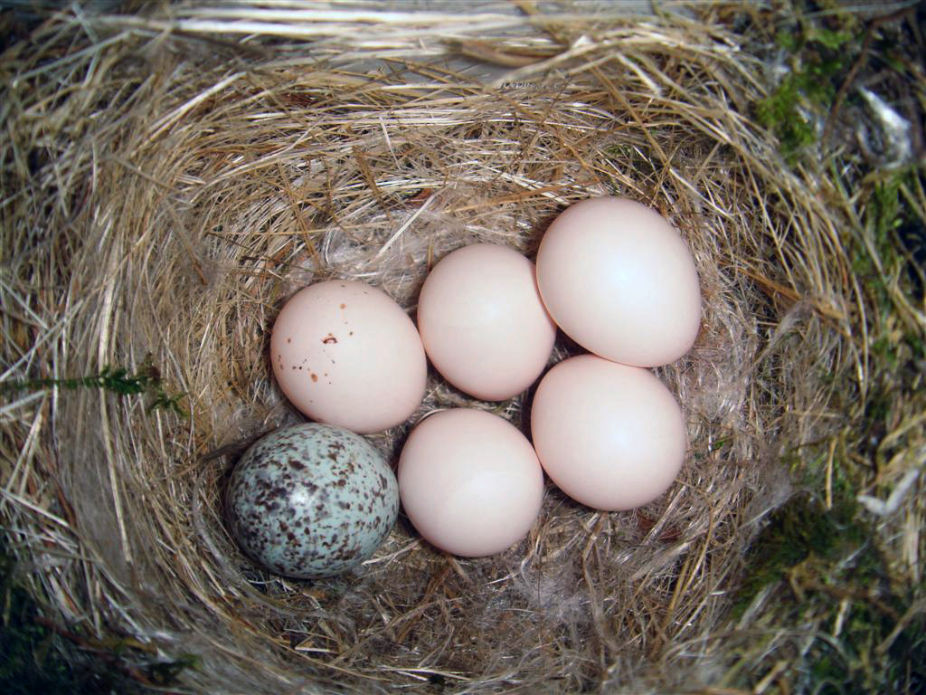
Definitions – Parasitism
Parasitism is an interaction relationship between two organisms living together in more or less intimate association in a relationship in which association is disadvantageous or destructive to one of the organisms.
40% of species are parasites, but the most of them are understudied.

Slide 6
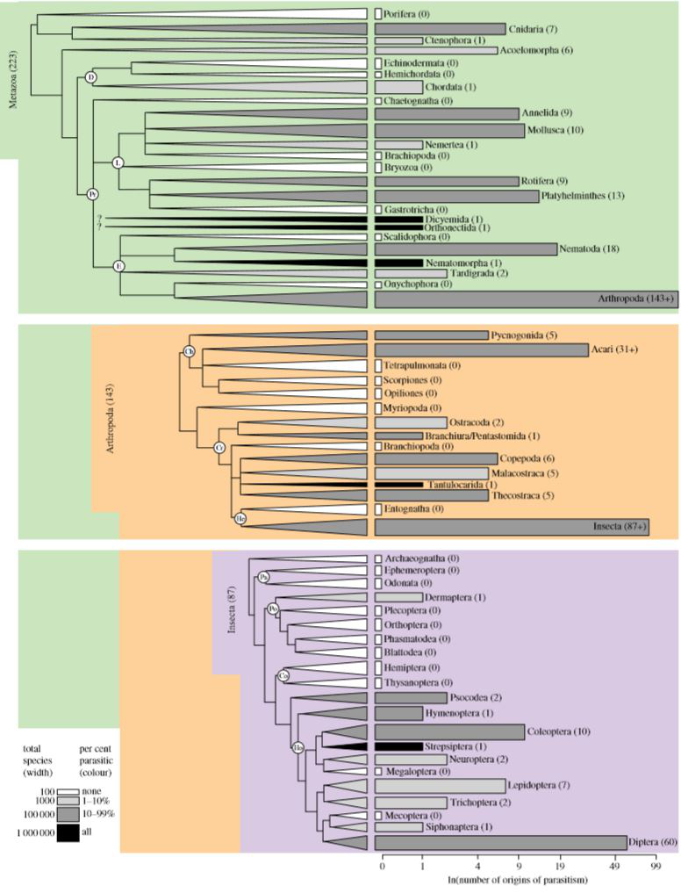
Motivation
Origins of Parasitism across Animalia
“Parasitism has evolved at least 223 times in Animalia.”
Weinstein SB, Kuris AM (2016) Independent origins of parasitism in Animalia.

Slide 7
Data
Tree:
Open Tree of Life
with Open Tree Taxonomy (OTT)
→ phylogenetic tree with identities common with GloBI
Data for Nodes:
Global Biotic Interactions (GloBI)
→ parasitism / freeliving state for leafnodes (species)

Slide 8
Data – Open Tree of Life
"Synthesis of phylogeny and taxonomy into a comprehensive tree of life.“
https://tree.opentreeoflife.org
construct of comprehensive, dynamic and digitally-available tree
synthesizing published phylogenetic trees along with taxonomic data
→ Reflects the overall phylogeny of life
~ 1.8. million named species
Most recognized species have never been included in a phylogenetic analysis.

Slide 9
Data – Open Tree Taxonomy (OTT)
synthesis of available taxonomies
It is open, extensible and updatable.
Tree version 9.1 with OTT version ott3.0
last update: March 22, 2017 (OTT: February 26, 2017)
Tips in synthetic tree: 2.637.204 (leaf nodes)
Taxon count: 3.594.550
Trees in synthesis: 819
Internal nodes: 229.801
→ not nearly binary

Slide 10
Data – Global Biotic Interactions (GloBI)
Infrastructure and data service:
aggregates existing species interaction data exposes them in a structured way
→ analyse, visualize and discover
http://www.globalbioticinteractions.org/

Slide 11
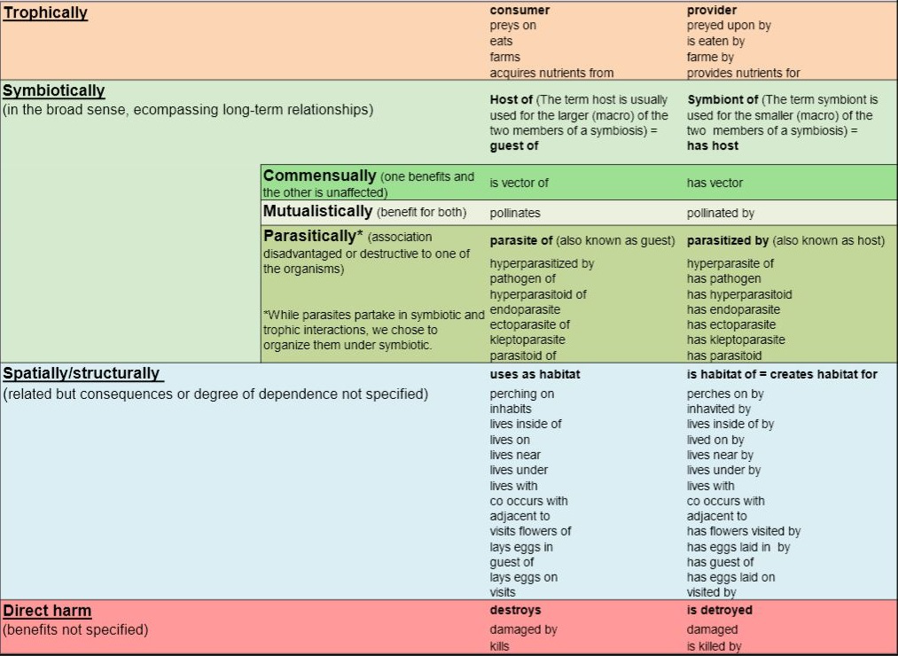
Data – Global Biotic Interactions (GloBI)

Slide 12
Methods for ancestral-state reconstruction (ASR)
Taxonomic Majority Censoring (TMC)
By Marius Bäsler
A simple mean-based numeric algorithm
Maximum Parsimony (MP)
minimizes the total number of character-state changes
Maximum Likelihood (ML) / Bayesian
statistical model: producing the most likely filled tree
2.637.204

Slide 13
Results – Marius Bäsler
Examination of the data from taxonomic tree:
Freeliving Count (distinct, leaf nodes): 39.593
Parasite Count (distinct, leaf nodes): 20.404
Origins of parasitism in Eukaryota (domain):
Metazoa: 828
Fungi: 325
Plants: 151
SAR: 37
2.637.204

Slide 14
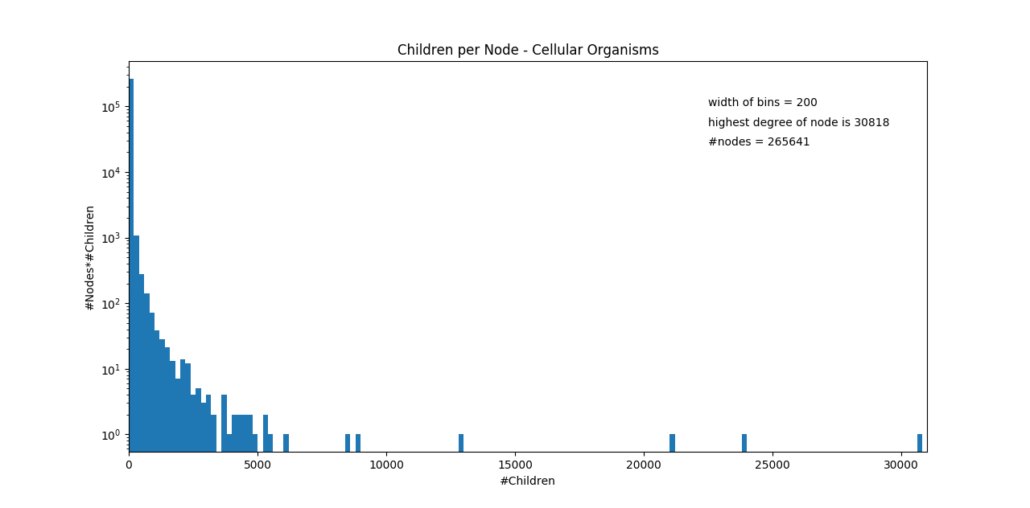
Results – tree analysis
2.637.204

Slide 15
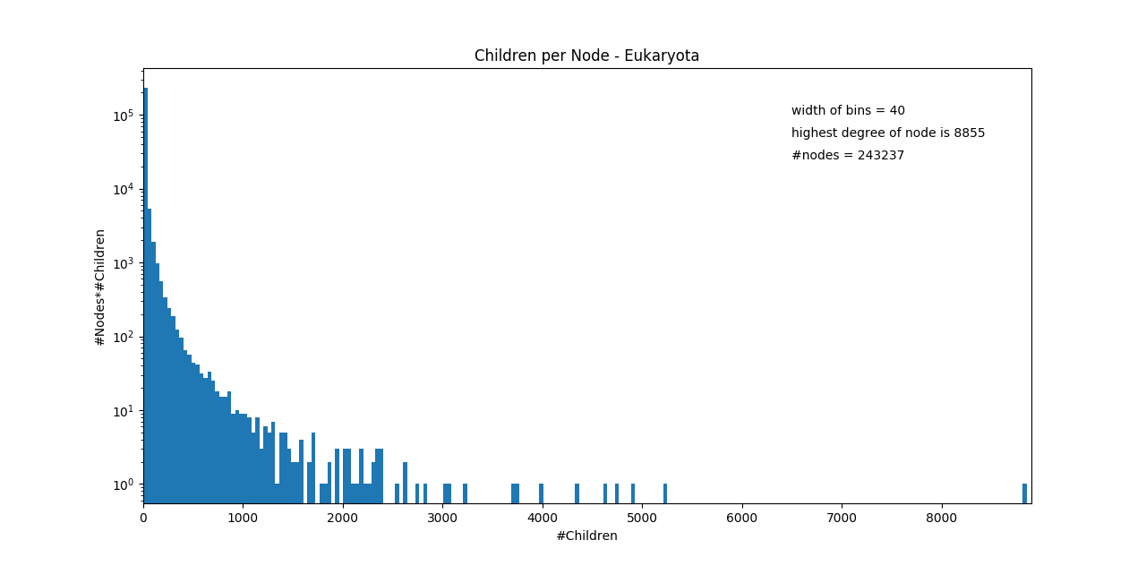
Results – tree analysis
2.637.204

Slide 16
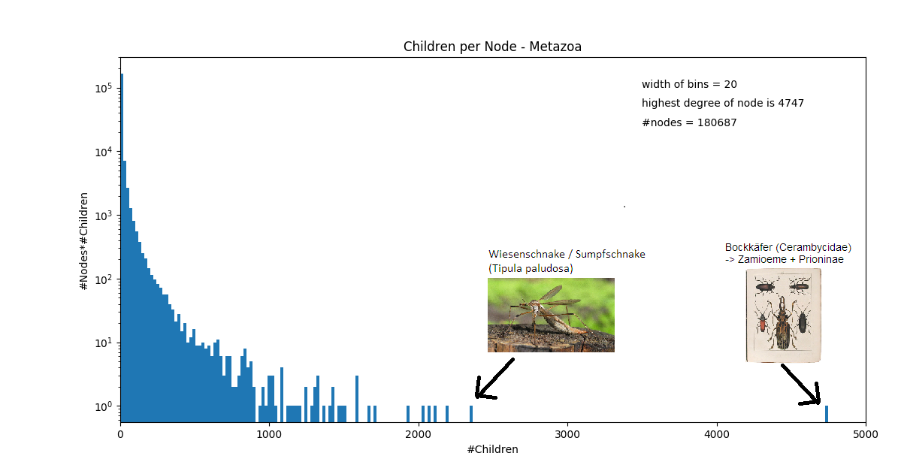
Results – tree analysis
2.637.204

Slide 17
Results - procedure
Import tree and interaction data into ArangoDB
Get species attributes from the interactions (AQL)
Tag leaf nodes with these attributes (parasite / freeliving) (AQL)
Resulting Tree:
http://127.0.0.1:8529/_db/_system/_admin/aardvark/index.html
2.637.204

Slide 18
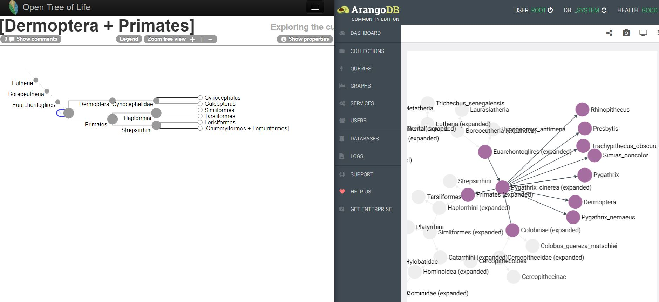
Results – imported tree

Slide 19
Timeline
Currently working on:
Try Marius TMC algorithm on the synthesis tree.
Define possible algorithms for calculating node properties.
Review existing implementations.
In the long run:
Use / attach / implement an algorithm to give the inner nodes attribute 'parasite' or 'freeliving'. → Find origins for parasitism.
Future work:
Add symbiontic or other attributes to the nodes.
Parsimony analysis of coevolving species associations + reconstruction the history of host-parasite associations. Reconstruction the history of host-parasite associations.
2.637.204

Slide 20
References
Independent origins of parasitism in Animalia (Sara B. Weinstein and Armand M. Kuris)
Global biotic interactions: An open infrastructure to share and analyze sepcies-interaction datasets (Jorrit H. Poelen, James D. Simons, Chris J. Mungall)
Tangled trees - Phylogeny, Cospeciation, and Coevolution (Book by Roderic D. M. Page)
Choosing the best ancestral character state reconstruction method ( Manuela Royer-Carenzi, Pierre Pontarotti, Gilles Didier – 2012)
Synthesis of phylogeny and taxonomy into a comprehensive tree of life (Hinchliff, Cody E., et al. - 2015)

Slide 21
References
Animalia Phylum Tree by opelate http://opelate.deviantart.com/art/Animalia-Phylum-Tree-20118810 (4.7.2017)
The Tree of Life - Edward Tufte forum: Evidence and assumptions in cladograms https://www.edwardtufte.com/bboard/q-and-a-fetch-msg?msg_id=00018e (4.7.2017)
Parasites - https://en.wikipedia.org/wiki/Parasitism

Slide 22
Thank you for your attention!
Questions?

